Slide 1
Speed detection of vehicles using yoloV4

Slide 2
GROUP -10
B.NAGA SRI HARINI –CB.SC.U4AIE24010
YOGESWAR - CB.SC.U4AIE24011
PRATHEEP - CB.SC.U4AIE24021
BHAVESH REDDY - CB.SC.U4AIE24034

Slide 3
INTRODUCTION:
Vehicle speed detection is very important in traffic management, policing, and highway safety.
As deep learning and computer vision technology have evolved, AI-based solutions provide a cost-efficient and scalable method for speeding detection.

Slide 4
OBJECTIVES:
1.Detection of vehicles in real time
2.Detection of vehicle registration plate
3.Detection of speed of the vehicles

Slide 5
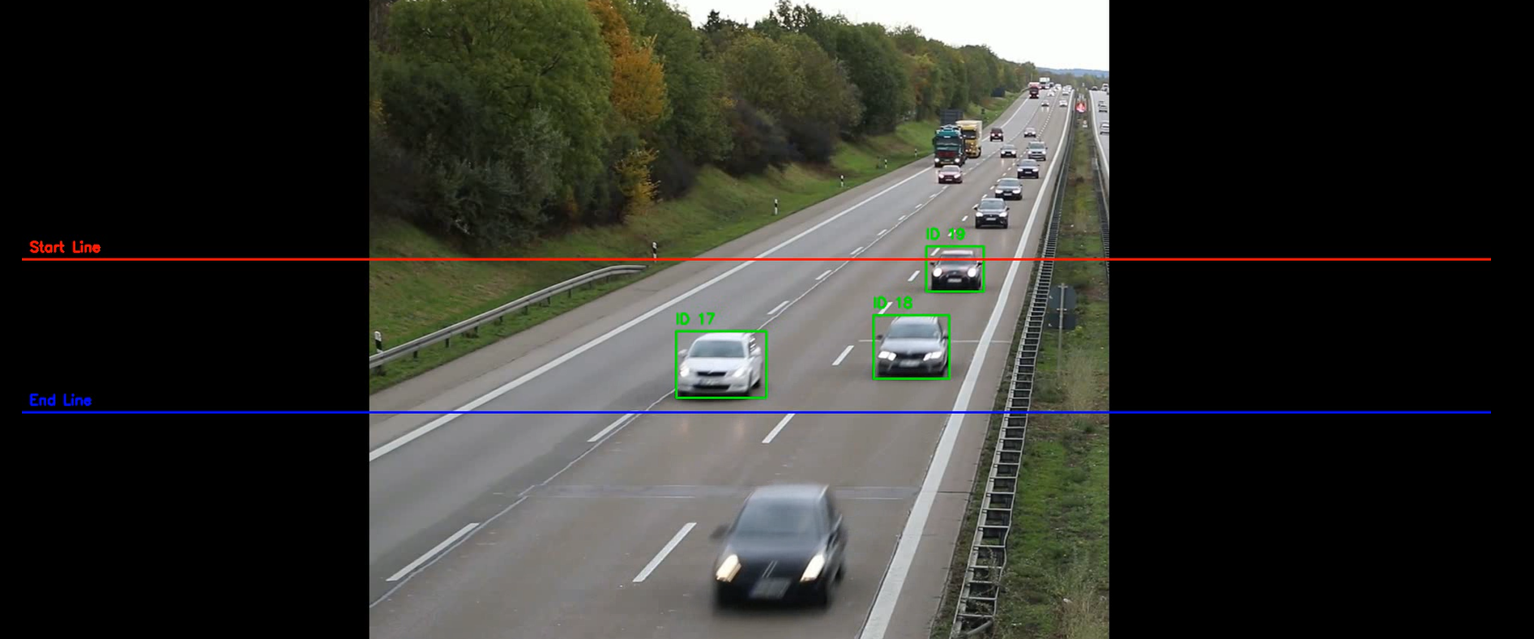
METHODOLOGY:
Speed detection:
DETECTION OF VEHICLES USING YOLOV4 FROM EACH FRAME between the specified lines and draw boundary boxes
Recording of the time how much time it is in between the lines
Speed is calculated from the time we got and distance
CONVERSION OF VIDEO INTO FRAMES
Used a pretrained YOLO model for detection of vehicles

Slide 6
VEHICLE REGISTRATION PLATE DETECTION:
VEHICLE REGISTRATION PLATE DETECTION:
Training YOLOV4 MODEL for detection of registration plates :
1.Collection of all the images to train
2.Collecting all the annotations of the images
3.Annotations in YOLO format are <class_id> <x_center> <y_center> <width> <height>
4.We get the Weights file after training the model
5.We use a configuration file to train the model 6. In that we got weights after 1000 iterations
Batch size:32
Sub divisions:16
CONVERSION OF VIDEO INTO FRAMES
DETECTION OF VEHICLE REGISTRATION PLATE USING YOLOV4 FROM EACH FRAME and draw boundary boxes

Slide 7

TRAINING OF YOLO MODEL
STEP-1-IMAGE PREPROCESSING:
Image is converted into pixels of dimensions [m,n,3] (RGB Image)
Normalization of pixel values
I/255
For training image is passed as a tensor
Input image=[N H W C]
STEP-2 CONVOLUTION
The image is passed in to convolution layers using some random filters
O – Feature map
I – Input image
K – Filter or kernel
Comparision of detected bounding boxes with the ground truths and getting better filters using by back propagation using gradient decent method

Slide 8
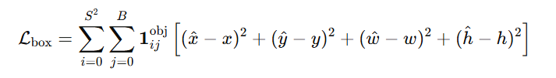
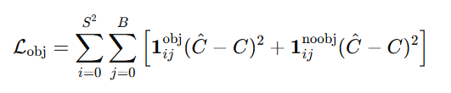

LOSS FUNCTIONS
1. Bounding Box Loss:Measures the error in the predicted bounding box (x, y, width, height) compared to the actual box. It uses Mean Squared Error (MSE).
2.Objectness Loss:
Measures how confident YOLO is about detecting an object inside a predicted box.
3.Classification Loss
Measures how well YOLO predicts the correct class for each object.

Slide 9




TOTAL LOSS:
UPDATING THE FILTERS:

Slide 10


1.Leaky RELU FUNCTION:
2.ReLU Function:
The standard ReLU function is defined as:
Unlike ReLU, Leaky ReLU allows small negative values (αx, where α is typically 0.1) instead of setting them to zero.
This prevents neurons from becoming inactive and improves feature extraction, especially in dark regions, blurry images, and low-light conditions.

Slide 11
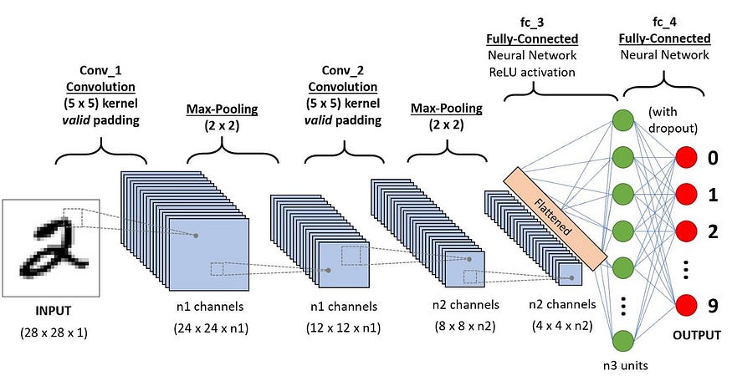

Slide 12
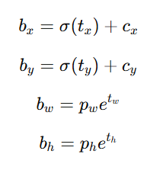
YOLO ALGORITHM FOR DETECTION OF OBJECTS
An image is pre-processed and converted into a tensor format.
The image is converted in to n x n grid
The image is now passed through the trained convolutional neural network weights
It also uses the anchor box predictions to draw the bounding box
Each grid is responsible for prediction of bounding box for which their centre falls under the grid cell
The bounding box off sets are detected using
convolution operations and corrected using
sigmoid function

Slide 13
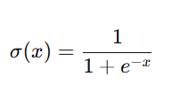
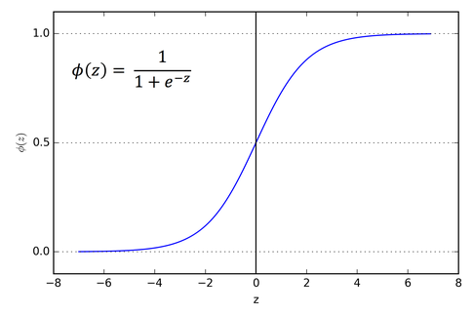
SIGMOID FUNCTION:
The range of this function is [0,1].
It converts any value given in to range.
The graph of sigmoid function:

Slide 14
FUTURE IMPLEMENTATIONS:
1.Detection of speed for both way travelling vehicles
2.Detection of vehicle registration plates in the video
3.Increase the accuracy of the speed.

Slide 15
THANK YOU

